Slide 1
PREDICTING PROPENSITY OF
INPATIENT ADMISSION IN THE 6
MONTHS
Enterprise Services - Summer Internship
By:
Raghav Rath
Piyusha S Shimpi
Ramya Sai Kapalavayi
Under the guidance of Pallavi Singh (Core Leader)

Slide 2
Agenda
Timeline
Problem Statement
Methodology
EDA
Modeling
Data Summary
Value Added
Learnings
Q&A
Appendix

Slide 3
Journey of our Internship
.
Problem Analysis
Research & Brainstorming
TRAINING
EDA
Model Training
Model Evaluation
Basic Python
Python Libraries
Machine Learning
PROBLEM
STATEMENT
Data Cleaning
Data Analysis & Visualization
MODELING
1
7
6
3
4
5
2

Slide 4

Problem Statement
Overview
Predicting the propensity of patients being admitted to a hospital within the next six months.

Slide 5



Methodology
Jan 1, 2017 – Jun 30, 2018
July 1 – Dec 31,2018
TRAINING DATA
TESTING DATA
Contents Title
DATA CLEANING
FEATURE ENGINEERING
MODELING AND EVALUATION
Removing duplicates.
Deriving columns & deleting unnecessary columns.
Imputing Null values.
Columns derived: Mean Length of Stay, Age-Groups, Visit Pattern, Air Quality and SDOH.
One-hot encoded: Procedures and Diseases.
XGBoost, ensemble learning technique combined with gradient boosting.
Model Evaluation: F1 score, accuracy, ROC curve.
Feature importance calculation.

Slide 6
Data Summary
Data Statistics:
No of encounters: 53,346
No of patients: 1,171
No of columns: 40
DATA
RAW
Columns dropped:
Marital status, Address, SSN, Name, Passport ID, Latitude and Longitude.
DROPPED
COLUMNS
Dropped duplicates and deceased patients:
No of patients: 989
No of encounters: 46038
DROPPED
ROWS
Cleaned data: | Till June 2018 | Training data(1.5 years)
No. of encounters | 43860 | 6321
No. of patients | 980 | 940
No. of columns | 45 | 45
DATA
CLEANED
Data provided by HAE team

Slide 7
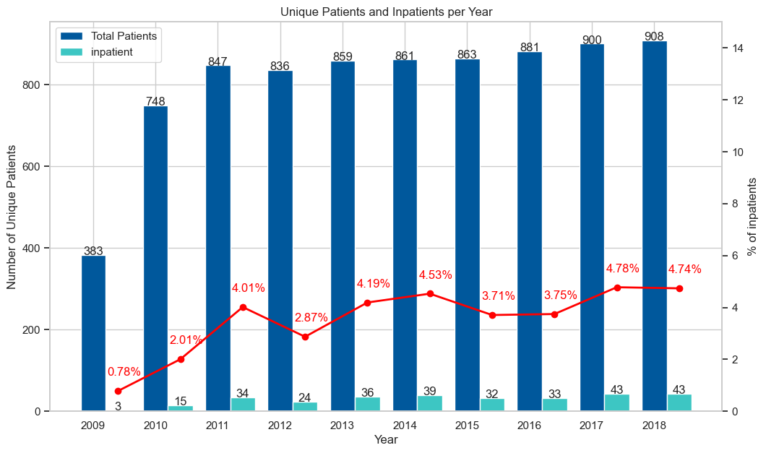
Yearly IP Patients
Insights:
Percentage of inpatients visiting hospital ranges from 2% to 5%.
Similar to the real-world percentage range of 2% to 8%.

Slide 8
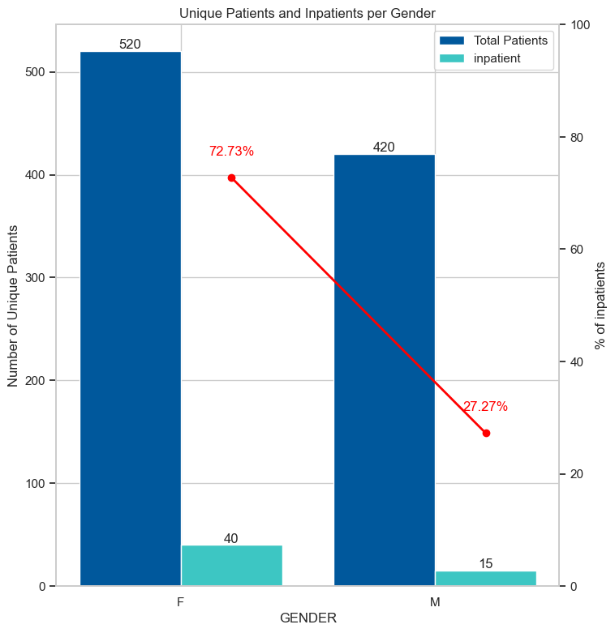
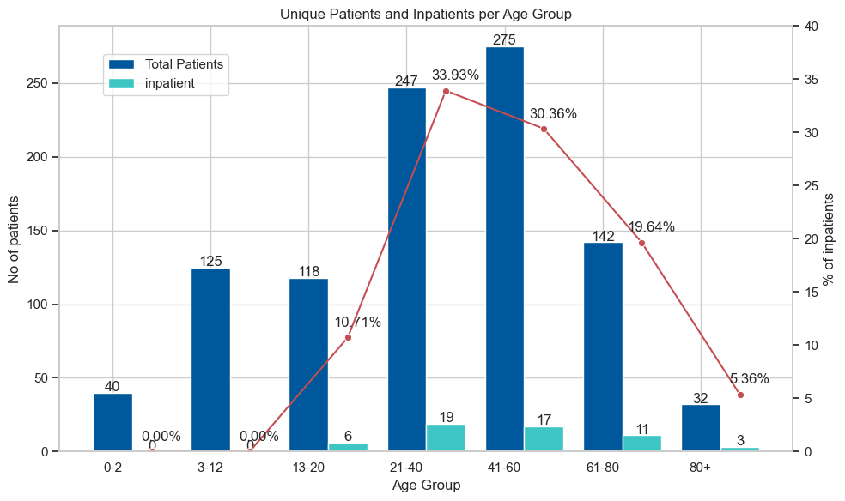
Inpatients’ Gender and Age Group
GENDER
AGE GROUP

Slide 9
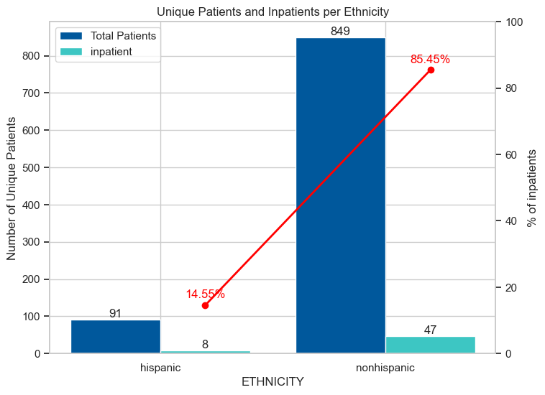
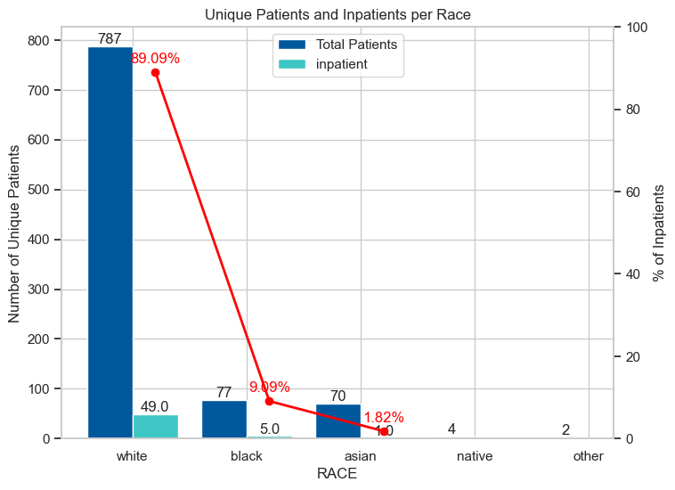
Inpatients’ Ethnicity & Race
ETHNICITY
RACE

Slide 10
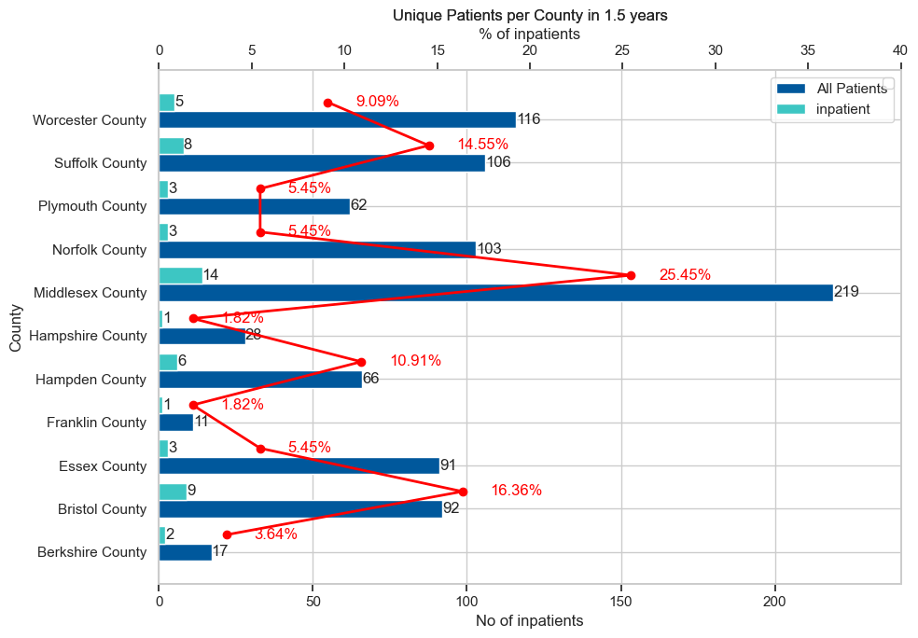
Inpatients’ County-Wise
Insights:
Middlesex boasts the highest number of inpatients with 14 individuals.
Franklin, Hampshire & Berkshire has the lowest percentage of inpatients.
Norfolk, Essex, and Hampshire exhibit a low inpatient rate, ranging from 2.9% to 3%.

Slide 11
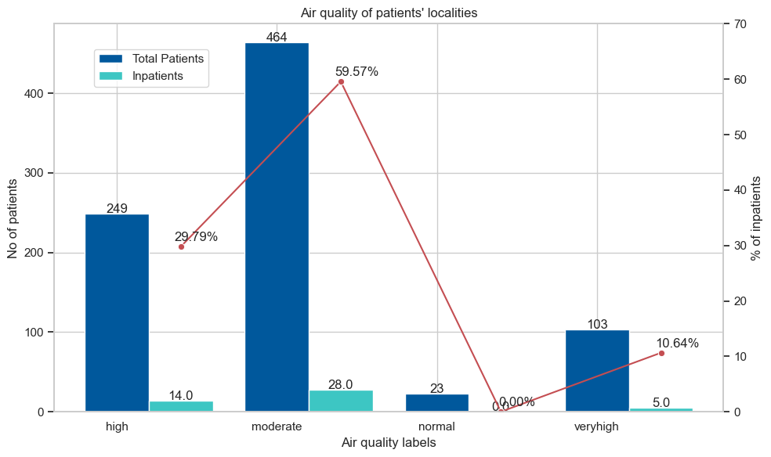
Air Quality of Patients’ Localities
Insights:
High percentage of inpatients belong to the moderate air quality localities.
No inpatients from areas with normal air quality.

Slide 12
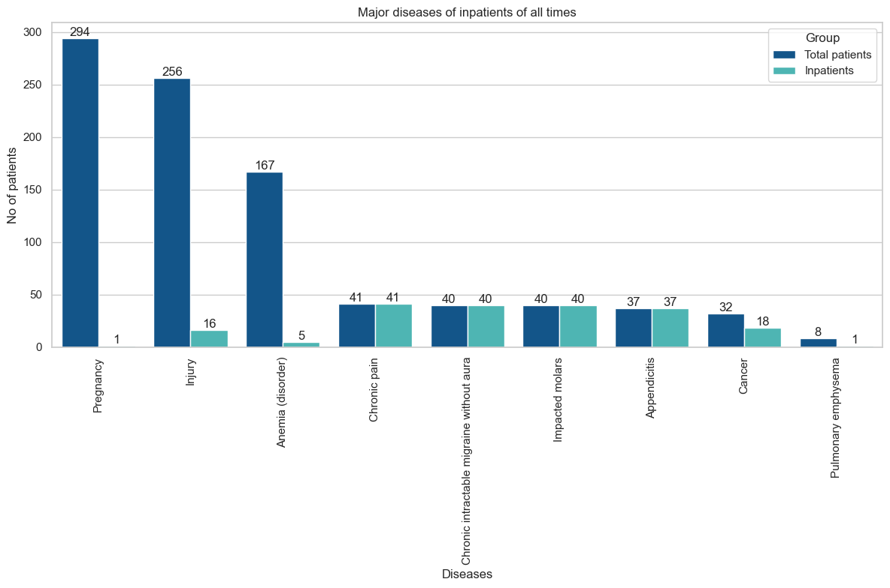
Top Historic Diseases
Insights:
Chronic Pain, Chronic Intractable Migraine without Aura, Impacted Molars, Appendicitis and Cancer are the major diseases which lead to inpatient admission.

Slide 13
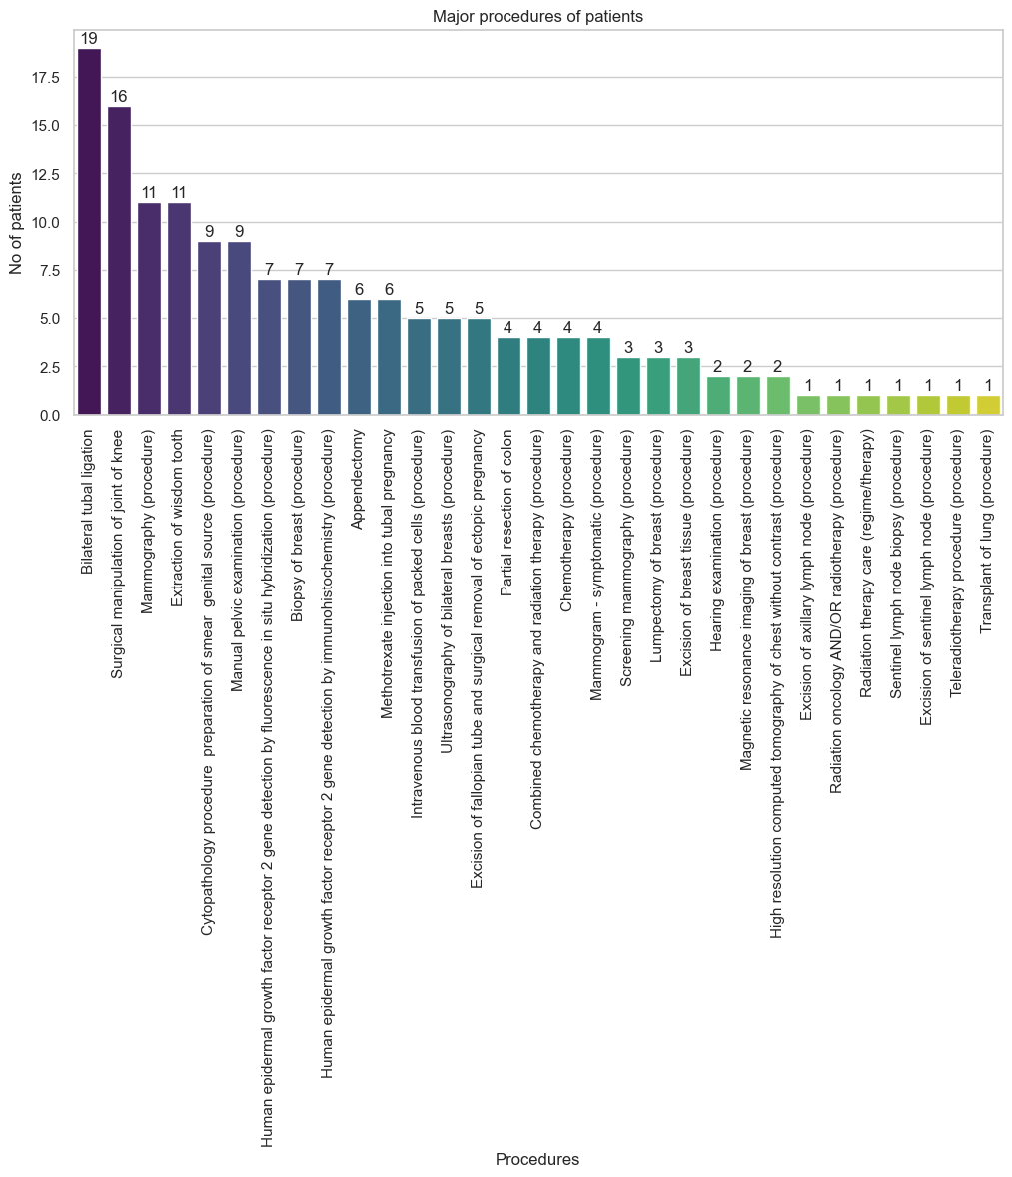
Top Historic Procedures
Insights:
Top historic procedures have a 100% inpatient rate with an exception of chemo and radiation combined therapy.
The major procedures are Bilateral Tubal Ligation, Surgical Manipulation of joint knee.

Slide 14
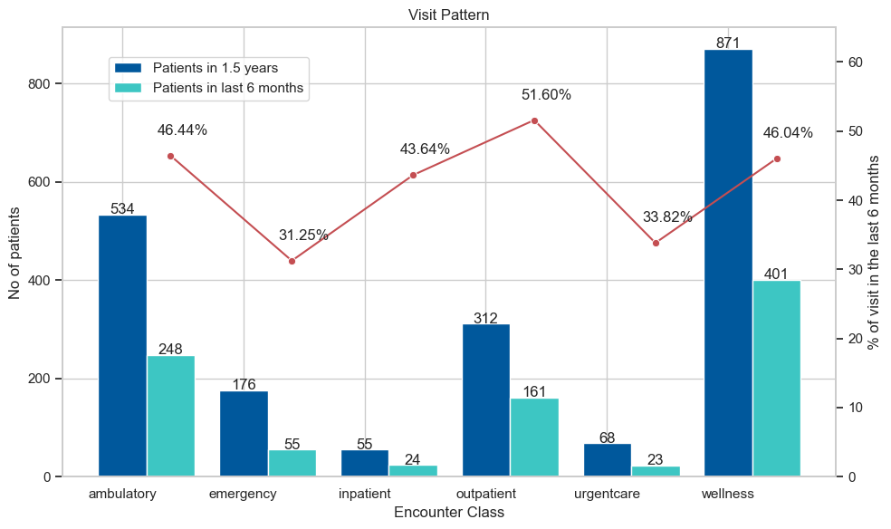
Visit Pattern
Insights:
Significant spike in the number of patients in outpatient, ambulatory, inpatient and wellness care over the last six months.

Slide 15
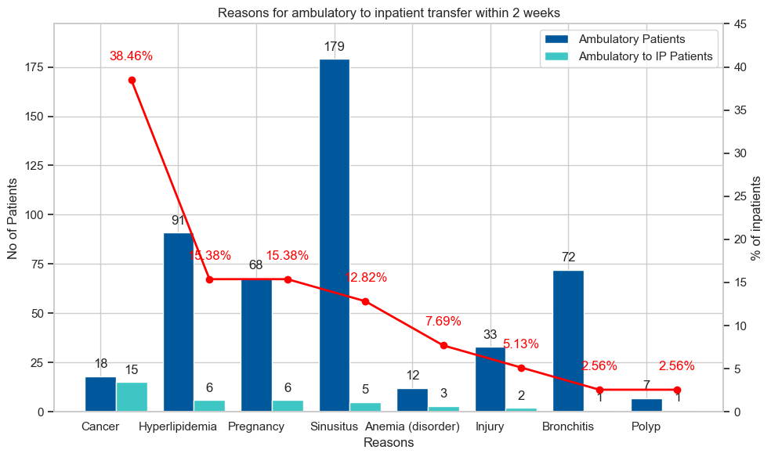
Major Diseases for Ambulatory to Inpatient Transfer
Insights:
Cancer had the highest composition of patients transferring from ambulatory to Inpatients encounter class within 2 weeks.
Bronchitis, Sinusitis had the least composition of patients transferring.

Slide 16
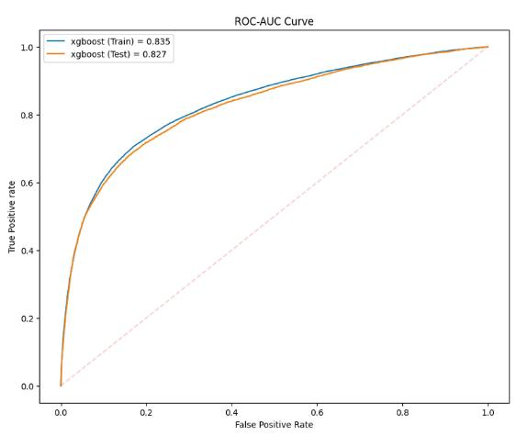
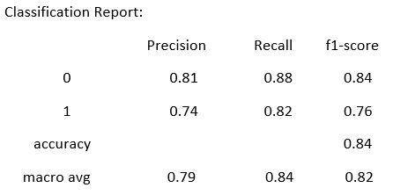
Model Results (XGBoost)
Confusion Matrix
AUC-ROC Curve
Actual Values
Classification Report

Slide 17
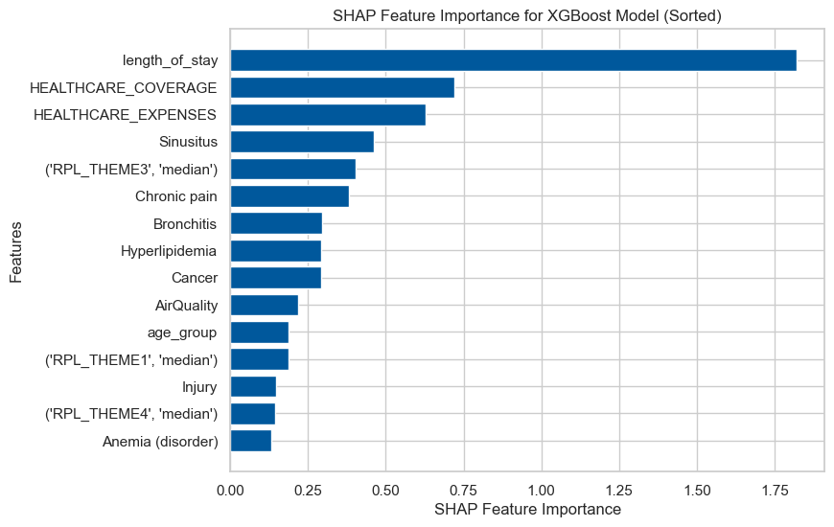
Feature Importance
KEY:
RPL_THEME1 - Socioeconomic
RPL_THEME2 - Household Composition & Disability
RPL_THEME3 - Minority Status & Language.
RPL_THEME4 – Housing type and Transportation

Slide 18
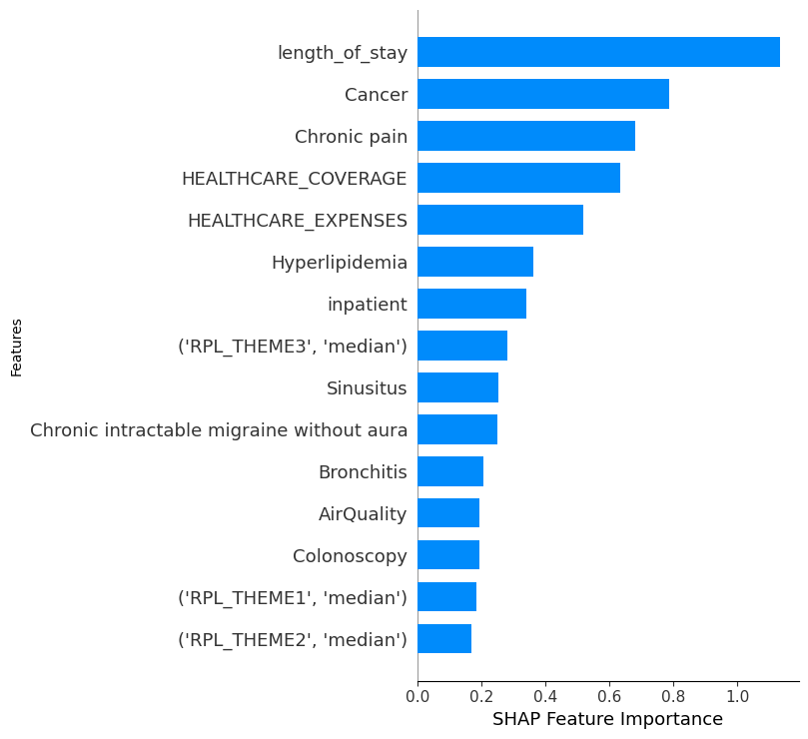
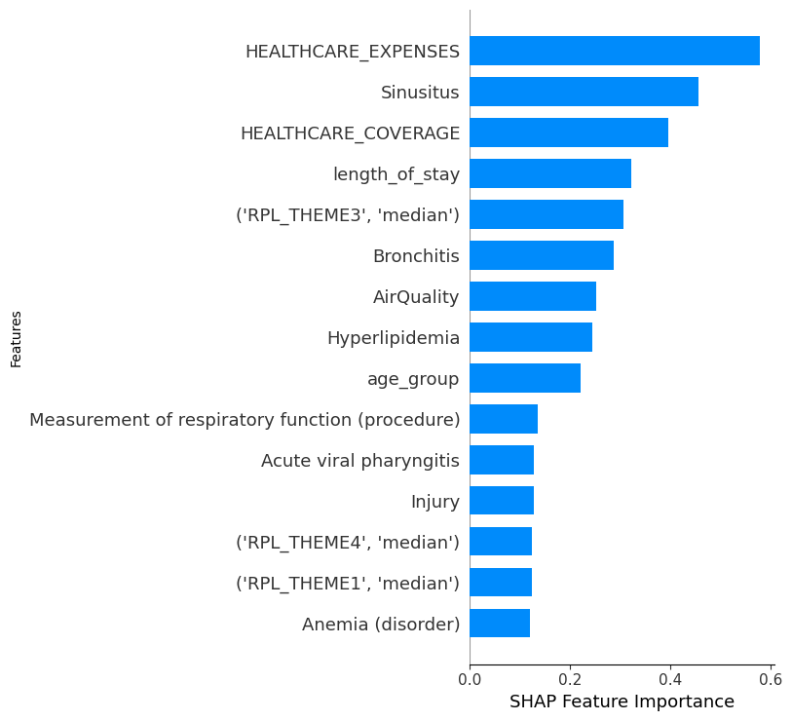
Causal Explanation
Admitted
Not-Admitted
The major factors leading to inpatient admission as per the model are length of stay, cancer, chronic pain and healthcare coverage.
Most of the patients visiting hospitals as inpatients have been suffering from either cancer or chronic pain and have a good healthcare insurance coverage.
The major reasons for patient not getting admitted as per the model are healthcare expenses, healthcare coverage and length of stay.
Most of the patients who are not getting admitted as inpatients are either poor or have had short encounters previously or are not covered by insurance.
The criticality of diseases is comparatively low.

Slide 19

Value Added
FINANCIAL MANAGEMENT
Planning and budgeting.
Revenue Estimation.
RESOURCE ALLOCATION
Helps to allocate resources such as Staff and Medical Supplies.
FINANCIAL
MANAGEMENT
RESOURCE
ALLOCATION
BED ALLOCATION
Helps hospitals to know the number of beds required and the point of time when bed demand will be high.
PREVENTIVE CARE INITIATIVES
Enables hospitals to implement targeted preventive care initiatives.
BED
ALLOCATION
PREVENTIVE
CARE
INITIATIVES
PATIENT
ENGAGMENT
PATIENT
QUALTIY
CARE
PATIENT QUALITY CARE
Help hospitals anticipate potential surges and prepare in advance.
Timely attention and treatment for patients.
PATIENT ENGAGEMENT
Helps in Patient Engagement.
Builds Trust among Patients.

Slide 20
Learnings
Learnings
TECHNICAL SKILLS
TECHNICAL SKILLS
SOFT SKILLS
Python
Effective Communication
Data Analysis
Teamwork
Data Visualization
Time Management
Machine Learning
Task Prioritization
20

Slide 21
Thank you!

Slide 22
Q&A

Slide 23
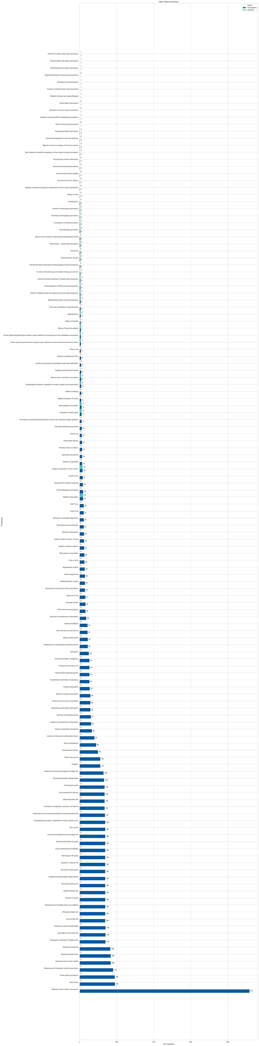

TOP PROCEDURES FOR IP PATIENTS – IP Patient history
Insights- Distribution of Inpatients
96.3 percent of the patients joined as inpatients for Medication Reconciliation which also brought in the highest inpatients
The following 14 top procedures had a comparable percentages of inpatients and total number of patients.

Slide 24
METHODOLOGY
Contents Title
PATIENT HISTORY
TRAINING DATA
TESTING DATA
Jan 1,
1915
Jan 1,
2017
Jun 30,
2018
Dec 30,
2019

Slide 25
Learnings
Technical
Soft Skills
Python
Data Analysis
Data Visualization
Machine Learning
Effective Communication
Team-work
Time Management
Task prioritization

Slide 26





Problem Overview
Resource Allocation & Planning
Financial Management
Patient Satisfaction & Engagement
Patient Quality Care

Slide 27
Proposed Solution
TITLE
Predicting the propensity of patients being admitted to a hospital within the next six months.
Analyzing trends and historical diseases of patients.
Long Term Vision

Slide 28


TIMELINE
.
DATA CLEANING
Modeling
You can simply impress your audience and add a unique zing and appeal to your Presentations.
Cleaned raw data and performed Exploratory Data Analysis
WEEK
WEEK
WEEK
WEEK
FEATURE
ENGINEERING
Learnt python and its libraries
Learnt Machine learning models
Included features like
Length of stay, air pollution index, SDOH themes ,etc into the model for prediction
.
TRAINING

Slide 29
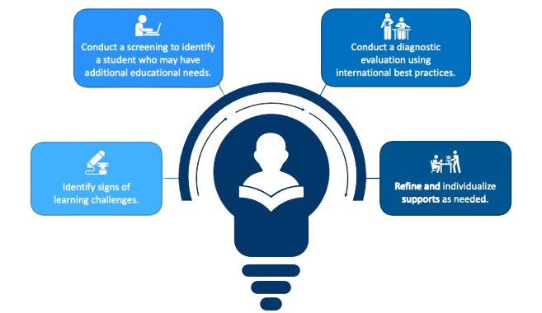
Timeline of our learning
Week 1-2
Week 3-4
Week 4-6
Week 6-7
DATA
PRE-PROCESSING
DATA
ANALYSIS
PYTHON
MACHINE
LEARNING

Slide 30
Learnings
Technical Skills
Soft Skills
Python
Data Analysis
Data Visualization
Machine Learning
Effective Communication
Team-work
Time Management
Task prioritization

Slide 31
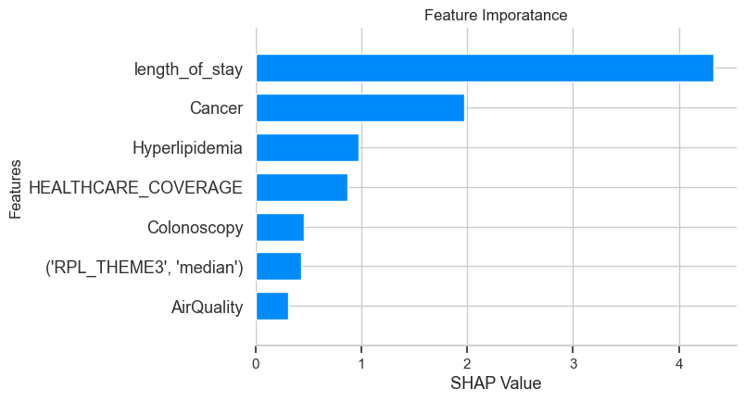

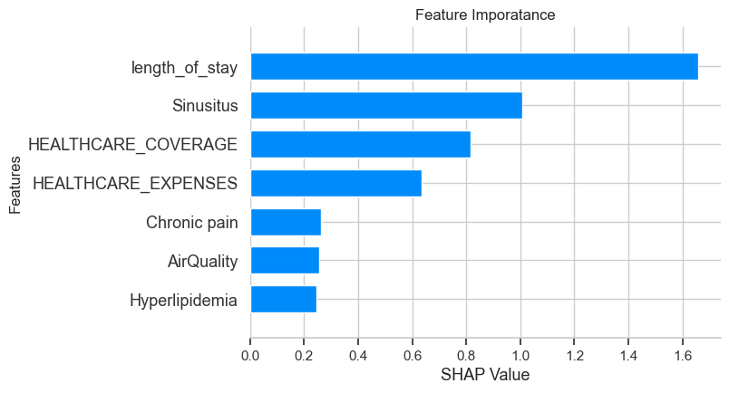

Causal Explanation
Admitted
Probability
Prediction | Probability
0 | 0.02596
1 | 0.97404
Patient is suffering from cancer and hyperlipidemia.​
Average length of previous encounters was high.
Has undergone a major colonoscopy procedure in recent past.
Not-Admitted
Probability
Prediction | Probability
0 | 0.9988768
1 | 0.0011232
Patient is not suffering from any major disease.​
Patient was not admitted in the last 6 months.
Belongs to a locality with moderate air quality index.

Slide 32
Causal Explanation
Admitted
Not-Admitted
Prediction | Probability
0 | 0.02596
1 | 0.97404
Prediction | Probability
0 | 0.9988768
1 | 0.0011232
Patient is suffering from cancer and hyperlipidemia.​
Average length of previous encounters was high.
Has undergone a major colonoscopy procedure in recent past.
Patient is not suffering from any major disease.​
Patient was not admitted in the last 6 months.
Belongs to a locality with moderate air quality index.

